Slide 1

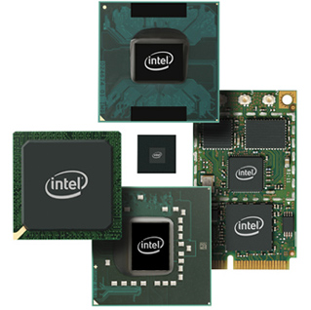
Pipeline Branch Prediction Strategies
Presented by
Bogki Yun,
Yuguang Qiu,
Qian Mai
April 8th, 2014

Slide 2
Outlines & Summary
1. Abstract
2. Background and Motivation
3. Static Branch Predictions
4. Dynamic Branch Predictions

Slide 3
1. Abstract
High performance achievement – Pipelining
Programs written for a pipelined processor try to avoid branching to minimize possible loss of the speed.
A pipeline uniprocessor can run at a rate that is limited by its slowest stage and increases instruction throughput by performing multiple operations in parallel.
Current method does not reduce instruction latency as it still must go through all steps to complete a single instruction from start to finish.

Slide 4
1. Abstract Cont.
Branch prediction scheme is required to fix this problem by minimize the performance penalty from branching.
If branches are predicted poorly, it may create more work for the processor.
Our project discusses and implements a simulator of branch prediction strategies with the goal of finding a method to maximize the rate of correct predict
Evaluate our ideas by comparing the performance of several existing prediction schemes and find some efficient methods to improve the branch prediction strategies

Slide 5
2. Background and Motivation
For a branch instruction, predict whether the branch will actually be TAKEN or NOT TAKEN
Pipeline bubbles(stalls) due to branch are the main source of performance degradation
Avoids pipeline bubbles by feeding the pipeline with the instructions in the predicted path(speculative)
Speculative execution significantly improves the performance of the deeply pipelined, wide issue superscalar processors
More accurate branch prediction is required because all speculative work beyond a branch must be thrown away if mispredicted
Performance=f(Accuracy, cost of misprediction)
Accuracy is better with Dynamic Prediction

Slide 6
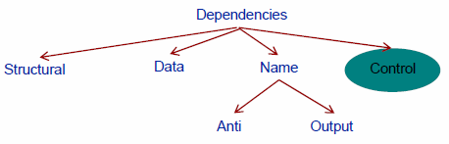

2.1 Control Dependencies
Core
Control dependencies determine execution order of instructions
Instructions may be control dependent on a branch
DADD R5, R6, R7 BNE R4, R2, CONTINUE DMUL R4, R2, R5 DSUB R4, R9, R5

Slide 7
2.2 Control Speculation
Execute instruction beyond a branch before the branch is resolved → Performance
Speculative execution
Difference between speculation and prediction?
What if mis-speculated?
Recovery mechanism
Squash instructions on the incorrect path
Branch prediction: Dynamic vs. Static
What to predict?

Slide 8
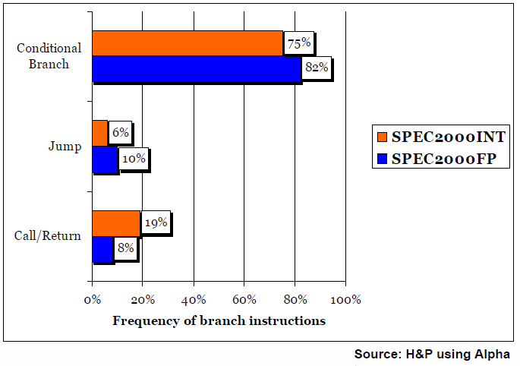
2.3 Categorizing Branches

Slide 9
2.4 Why Branch is Predictable?
If (aa == 2) aa = 0;
if (bb == 2) bb = 0;
If (aa != bb) ……..
for (i= 0; i< 100; i++) {
……..
}
addi r2, r0, 2 bne r10, r2, L_bb xor r10, r10, r10 j L_exit L_bb: bne r11, r2, L_xx xor r11, r11, r11 j L_exit L_xx: beq r10, r11, L_exit …. L_exit
addi r10, r0, 100 addi r1, r0, r0
L1:
…. …. …. …. addi r1, r1, 1 bne r1, r10, L1
…. ….

Slide 10
2.5 Various Features
Mapping
Direct mapping
Fully associative mapping
Set associative mapping
N-bit counter
1-bit counter
2-bit counter
Buffer size

Slide 11
2.5 Various Features(cont.)
Three Information Sources
Branch Address
Global Branch History
Local History Table
Problems
Aliasing
Context switches

Slide 12
1-bit Branch Prediction
Maintain a branch-prediction buffer (branch history table), recording last behavior of branch:
Small memory buffer indexed by least significant bits of branch instruction address
0 x 4 0 0 0 0 0 3 c : B E Q Z R 2, l a b e l
LSB | Predictor
: | :
111100 | 0
: | :
Branch Untaken
Branch Taken

Slide 13
1-bit Branch Prediction
Branch mispredicted: invert predictor bit and store back into branch-prediction buffer
Branch may have changed behavior (e.g., loop exit)
another branch may have overwritten the entry.
CPU always assumes the predictor bit to be correct and starts fetching instructions from target (1) or fall through (0)
Most useful for pipelines that determine branch target address early (and evaluate condition later on)

Slide 14
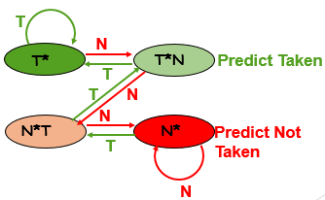
2-bit Branch Prediction
For a 2-bit branch predictor, a prediction must miss twice before it is changed:
Predict Taken
Predict Not
Taken
Red: stop, not taken
Green: go, taken
(Jim Smith, 1981)

Slide 15
Classification of branch prediction
Static branch prediction
Always untaken
Always taken
Dynamic branch prediction
One-level branch prediction
Two-level branch prediction
Hybrid branch prediction

Slide 16
3. Static branch prediction
The simplest one
Not rely on information about the dynamic history of code executing.
Used in processors where the expectation is that branch behavior is highly predictable at compile.
Need to predict branch statically during compile
Simplest scheme is to predict a branch as taken
Average misprediction = untaken branch frequency =34%

Slide 17
3. Static branch prediction
Option #1: based on type or use of instruction
E.g., assume backwards branches are taken (predicting a loop)
Can be used as a backup even if dynamic schemes are used
Option #2: compiler or profile branch prediction
Collect information from instrumented run(s)
Recompile program with branch annotations (hints) for prediction
!!!Can achieve 75% to 80% prediction accuracy

Slide 18
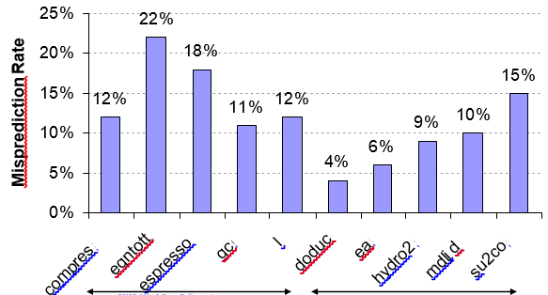
3. Static branch prediction
Integer
Floating Points

Slide 19
3. Static branch prediction
Always Untaken
Always untaken scheme just constantly returns the address of the next instruction
No fetch bubbles (always just fetch the next line)
Does horribly on previous “for loop” example
00xx
Return

Slide 20
3. Static branch prediction
Always Taken
Uses branch target address buffer (BTA buffer) to store and re-use target addresses
Each time the branch is resolved, the corresponding target address is stored in the BTA cache
The next time, always predicts the branch outcome as taken, retrieves the corresponding branch target address from this cache, and uses this address to fetch the next instruction

Slide 21
3. Static branch prediction
Another ways
Predict on the basis of branch direction?
Choosing backward-going branches to be taken (loop)
Forward-going branches to be not taken (if)
SPEC programs, however, most forward-going branches are taken =>
predict taken is better
Predict branches on the basis of profile information collected from earlier runs
Mis-prediction varies from 5% to 22%

Slide 22
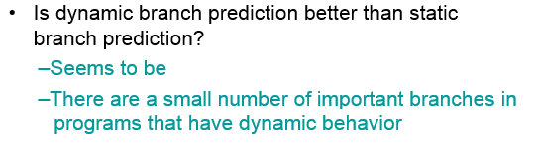
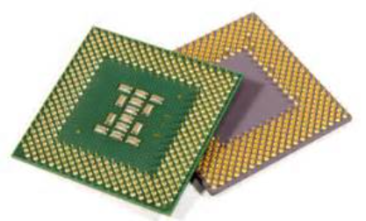
4. Dynamic branch prediction

Slide 23

4. Dynamic branch prediction
Performance = f (accuracy, cost of misprediction)
Branch History Table (BHT): table of 1-bit values indexed by lower bits of PC address index
Says whether or not branch taken last time
No address check (may refer to wrong branch)
Problem : In loop, 1-bit BHT will cause two misprediction (avg is 9 loop iterations before exit):
End of loop, when it exits instead of looping as before

Slide 24
One-level branch prediction
Decode History Table (DHT)
Branch History Table (BHT)
Combination DHT-BHT

Slide 25
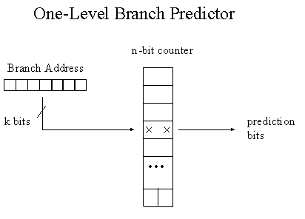
One-level branch prediction
Each entry
Single column table with 2^{k} entries
Each time
{
If (the branch is taken the counter is incremented)
if (the maximum value is already reached)
nothing is done.
}
Else
{
if (the minimum value = 0)
it stays the same
}
Information source
Direct mapping

Slide 26
Decode History Table (DHT)
Uses the address of the branch instruction to index the global table of prediction bits.
Low bits of the address are used to index directly into the table entry.
This method is the cheapest in terms of hardware.

Slide 27
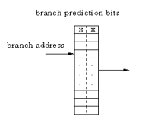
Decode History Table (DHT)
Used to predict branch outcome
The branch outcome is actually “known”
UPDATE!
number of bits(order) = 2 ´ 2^{(order)}

Slide 28
Branch History Table (BHT)
BHT is similar to DHT, except that it uses the tagged structure.
Each entry in the table, in addition to prediction bits, contains the address of the branch instruction.
It introduces the concept of hit and miss.
Removes all aliasing, so any branch prediction bits, associated with one branch instruction, can NOT be affected by another branch instruction

Slide 29
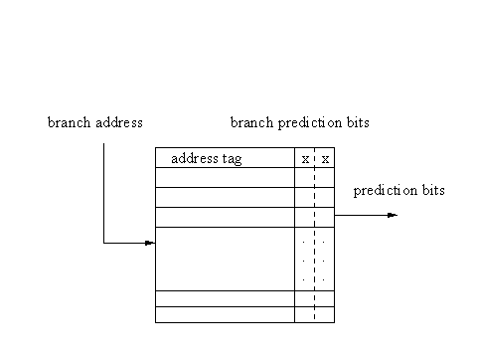
Branch History Table (BHT)
An entry is referenced
If (it matches) -> hit occurs & the predictions bits used to predict the branch outcome
Else (miss happens) -> the branch is predicted as not taken
number of bits(order) = (2 + 32) ´ 2(order)

Slide 30
Combination of DHT-BHT
This scheme is a combination of the previous two schemes.
This scheme accesses BHT, and, if there is a hit, it uses prediction bits from BHT to predict the branch outcome. Otherwise, DHT is indexed and prediction bits are retrieved from the corresponding entry of DHT.
The main advantage of this scheme is that we can make DHT much larger than BHT because of its low hardware requirements.

Slide 31
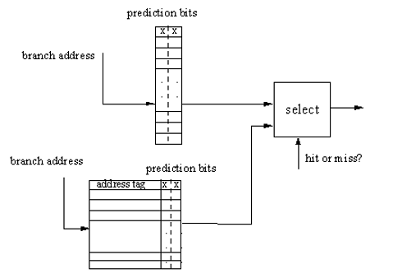
Combination of DHT-BHT
If hit occurs, DHT is not updated after the branch outcome is known.
number of bits(order1, order2) = 2 ´ 2(order1) + (2 + 32) ´ 2(order2)

Slide 32
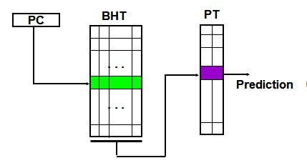
Two-level Self predictor
First level
Record previous few outcomes(history) of the branch itself
Branch History Table(BHT) - A shift register
Second Level
Predictor Table(PT) indexed by history pattern captured by BHT
Each entry is a 2-bit counter

Slide 33
Two-level predictor Organization
Branch history register (BHR) table
Indexed by Instruction address(Bi)
Branch history of last k branches
Local predictor: The last k occurrences of the same branch (Ri,c-kRi,c-k+1….Ri,c-1)
Global predictor: The last k branches encountered
Implemented by k-bit shift register

Slide 34
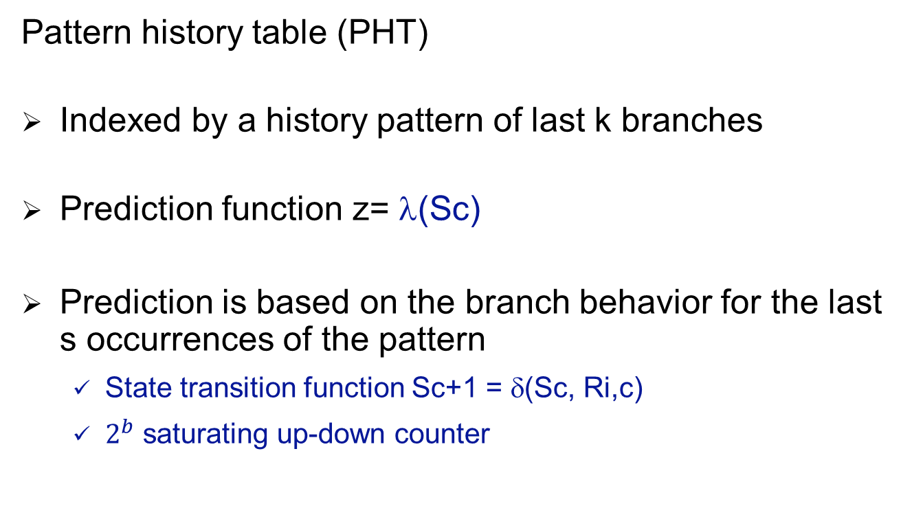
Two-level predictor Organization
Pattern history table (PHT)
Indexed by a history pattern of last k branches
Prediction function z= λ(Sc)
Prediction is based on the branch behavior for the last s occurrences of the pattern
State transition function Sc+1 = δ(Sc, Ri,c)
$2^{b}$ saturating up-down counter

Slide 35
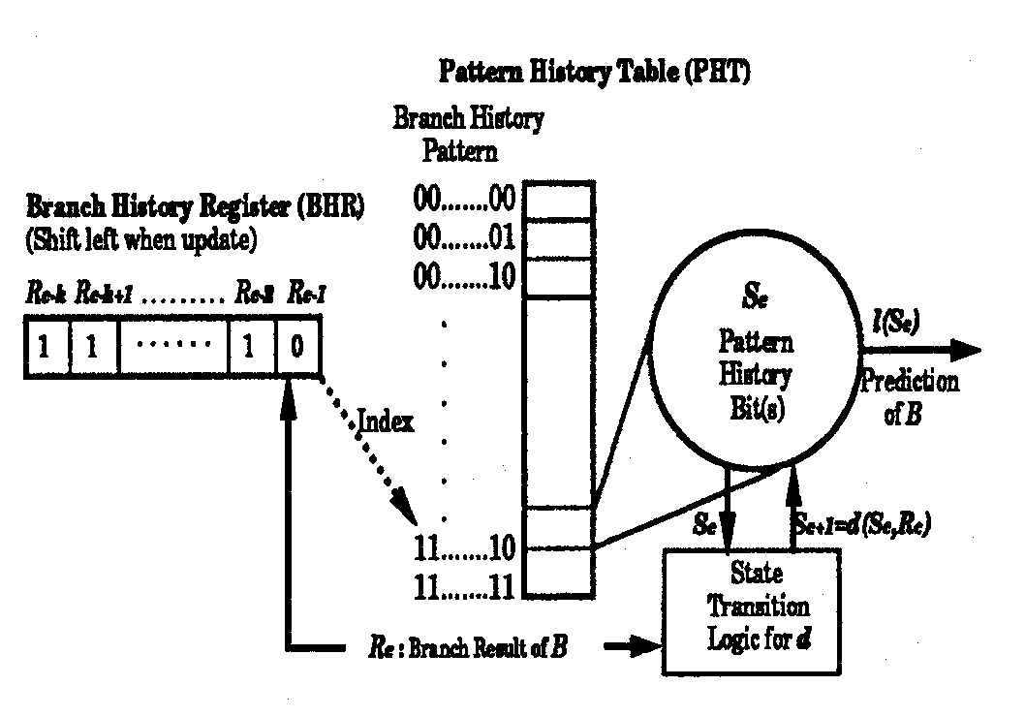
Two-level predictor Structure
Two-level predictor Structure

Slide 36
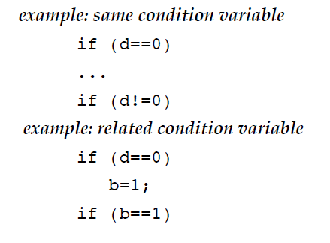
Correlating Branches
The Rationale:
Having the prediction depend on the outcome of only 1 branch might produce bad predictions
Some branch outcomes are correlated

Slide 37
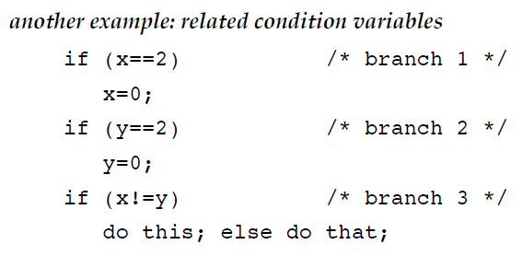
Correlating Branches
if branches 1 & 2 are taken, branch 3 is not taken
⇒ use a history of the past m branches represents a path through the program (but still n bits of prediction)

Slide 38
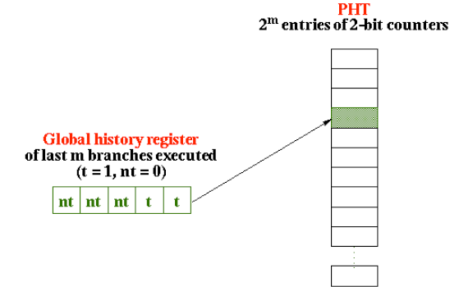
Correlating Branches
General idea of correlated branch prediction:
put the global branch history in a global history register
global history is a shift register: shift left in the new branch outcome
use its value to access a pattern history table (PHT) of 2-bit saturating counters

Slide 39
Correlating Branches
Access a row in the “partitioned” PHT with the low-order bits of branch address
Choose which PHT with the global branch history
Contents is the prediction

Slide 40
Gshare Branch Predictor
Gshare : Global history with index Sharing
McFarling suggest in 1993
Both Global history (BHR) and Branch address - using XOR to index into the PHT
Global branch history and pattern history
Hardware Cost for k history (BHR) bits - k + 2 x 2^{k} bits
Notes:
McFarling noted (1993) that using global history information might be less efficient than simply using the address of the branch instruction, especially for small predictors (why?).
He suggests using both global history (BHR) and branch address by hashing them together. He proposed using the XOR of global k-bit branch history register (BHR) and k low branch address bits to index into the second level PHT.
Since he expects that this indexing function to distribute pattern history states used more evenly among available predictors (in second level PHT) than just using the BHR as an index (GAg).
The result is that this mechanism reduces the level of index aliasing and resulting interference and thus outperforms conventional global schemes (e.g GAg, GAp).
This mechanism uses less hardware than GAp, since both branch history (first level) and pattern history (second level) are kept globally (similar to GAg).
The hardware cost for k history (BHR) bits is k + 2 x 2^{k} bits, neglecting costs for logic (Cost similar to GAg).

Slide 41
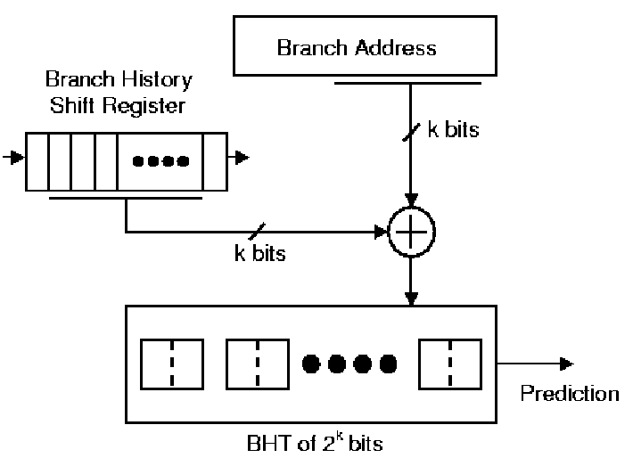
G-share Predictors
Branch and pattern history are kept globally. History and branch address are XORed and the result is used to index the PHT
First Level
Here a = k
BHR
(k bits)
k low bits of branch address
XOR
(bitwise XOR)
2-bit saturating counters (predictors)
Index Into Second Level
Second Level
One PHT
One Pattern History Table (PHT) with 2^{k} entries (predictors)

Slide 42
Skewed Branch Predictor
Michaud, Seznec, Uhlig, 1997
Most aliasing occurs lack of Associativity in PHT
The major contribution of aliasing is conflict aliasing, not capacity aliasing
The best way to deal with conflict aliasing is to make set associative in PHT. - But, this requires tags, and is not cost effective.
Instead, Skewed is using Skewing Function
Splits PHT into 3 banks (f1, f2, f3) - Each bank using unique hashing function per bank
The prediction is made according to majority vote among the three banks
Notes:
Based on the observation that most aliasing occurs not because the size of the PHT is too small, but because of a lack of associativity in the PHT
The major contributor to aliasing is conflict aliasing and not capacity aliasing.
The best way to deal with conflict aliasing is to make the PHT set associative, but this requires tags, and is not cost-effective.
Instead, the skewed predictor emulates associativity using a special skewing functions.
The skewed branch predictor splits the PHT into three even banks and hashes each index to a 2-bit saturating counter in each bank using a unique hashing function per bank (f1, f2 and f3).
The prediction is made according to a majority vote among the three banks. - If the prediction is wrong all three banks are updated. If the prediction is correct, only the banks that made a correct prediction will be updated (partial updating).
The reasoning behind partial updating is that if a bank gives a misprediction while the other two give correct predictions, the bank with the misprediction probably holds information which belongs to a different aliased branch. In order to maintain the accuracy of the other branch, this bank is not updated.
The skewed branch predictor tries to eliminate all aliasing instances and therefore all destructive aliasing. Unlike the other methods, it tries to eliminate destructive aliasing between branch instances which obey the bias and those which do not.

Slide 43
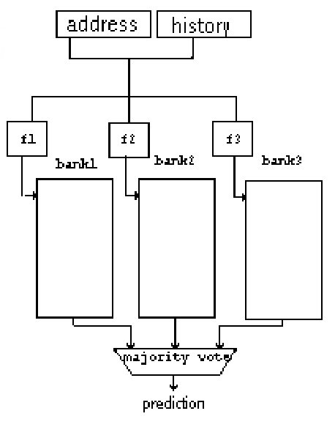
Skewed Branch Predictor
First Level
(BHR)
k-bits
k low bits
k bits
Three different “skewed” hashing (indexing) functions f1 , f2, f3 with inter-bank dispersion (i.e different mapping/distributions) are used to index each PHT bank in the second level
Second Level:
Three PHT banks
Update Policy:
If the prediction is wrong, all three banks are updated.
If the prediction is correct, only the banks that made
a correct prediction will be updated (partial updating).
One PHT
Majority Vote
Partial Updating

Slide 44
Flaws and limitation of
The subject matter
Major limiting factor in Instruction Level Parallelism today
Fast and accurate branch prediction is required
Older bit counter schemes are less effective than “Perceptions” predictors, however, still under widely usage.
Proposed hybrids of bit counters and perceptions do NOT work well.

Slide 45
Implementation
After we implemented all these methods, we tried to look on some new approaches and improvements. We didn’t reinvent the wheel and we just slightly modified the best scheme.
The best scheme happened to be the two-level adaptive predictor. We modified it to shift both taken bit and correct bit (whether the prediction was correct) into the correlation register.

Slide 46
Implementation issues
Branch prediction bits table size
Number of prediction bits in each entry
Branch Target Address(BTA) cache size
Non-associative vs. associative cache for BTA
Fully associative array of branch prediction bits vs. direct mapped array (in BHT)
BTA buffer update policy (always update or only when the branch is taken)
Number of history bits in the shift register
Hash function choice: - take low bits of branch instruction address or - use more complicated operations
How to combine history bits and PC: Concatenate, XOR

Slide 47
Reference
[1] Smith, J.E., “A Study of Branch Prediction Strategies”, Proceedings of the 8th annual symposium on Computer Architectures 1981, IEEE Computer Society Press: Minneapolis, Minnesota, USA. p. 135-148
[2] Yeh, T.-Y. and Y.N. Patt, “Two-level adaptive training branch prediction”, Proceedings of the 24th annual international symposium on Microarchitecture 1991.
[3] McFarling, “Combining Branch Predictors”, WRL Technical Note TN-36, Digital Equipment Corporation, June 1993
[4] Michaud, Pierre, Andre Siznec, Richard Uhlig, “Skewed branch predictors”, Tech. report, IRISA publ. int. 1031, June 1996
[5] Michaud, P., et al., “Trading conflict and capacity Aliasing in conditional branch predictors”, Proceedings of the 24th annual international symposium on Computer architecture, 1997.
[6] McFarling, S., “Combining branch predictors”, Compaq Computer Corporation Western Research Laboratory, 1993.
[7] D. Burger, T.M.A., and S.Bennett, “Evaluating future micro-processors: the SimpleSclar tool set”, Technical Report CS-TR-1996-1308, University of Wisconsin-Madison, 1996

Slide 48


Any questions

Slide 49




THANK YOU!

